Slide 1

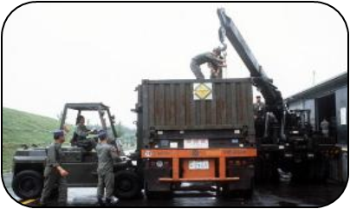

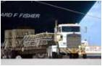
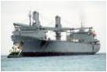


PALITS (Packaging and Logistics Integrated Transfer Solution)
79th MORS Symposium
June 20-23, 2011
UNCLASSIFIED
1
Notes:
Booz Allen Hamilton Standard Colors
Colors should be used in the color pairs whenever possible. Do not mix and match colors, use pairs together as shown.
Black, White and Gray can be used with any of the other colors.
Purple Pantone 2765
R 12
G 4
B 79
Green Pantone 357
R 15
G 67
B 24
Blue Pantone 2 88
R 11
G 31
B 101
Black
Pantone Cool Gray 6
R 158
G 158
B 158
Red Pantone 485
R 252
G 5
B 14
Yellow Pantone 3965
R 232
G 244
B 4
Aqua Pantone 319
R 126
G 204
B 189
White

Slide 2
AGENDA Project Overview Approach Integration Model Development Output and Analysis Q&A

Slide 3
Project Overview: Support analysis of US Pacific Command OPLANS
United States Pacific Command, Logistics Readiness Division (PACOM J42) tasked Booz Allen Hamilton to:
Develop an executable end-to-end distribution plan which addresses Joint munitions requirements
Address all known component command requirements and theater limitations
Establish a baseline of current distribution capability
Project future capability based on known force structure and infrastructure changes
Companion analysis to deliver detail of how conclusions were reached
Provide actionable recommendations
Project spanned about 12 months (September 2010 – August 2011)
Notes:
Briefly highlight the major drivers of the study

Slide 4
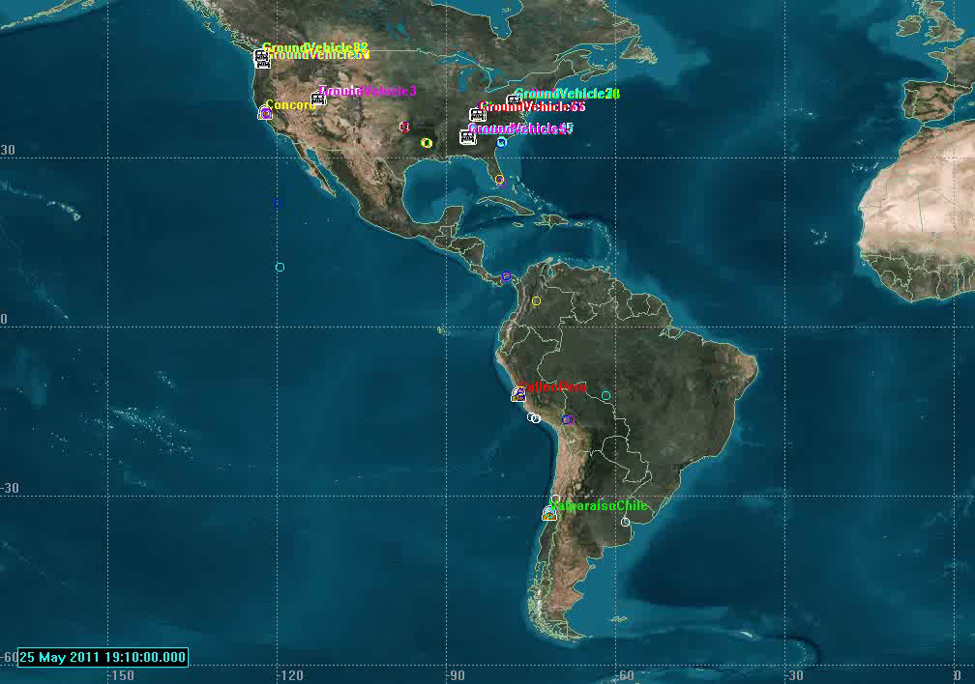
Project Overview: Streaming Video is Worth a Thousand Words
Scope: Global – Theatre
Technique: Stochastic model
Application: Operations and Planning Evaluation
Notes:
Just give a brief description of the video to introduce audience to project

Slide 5
Project Overview: High-Level Modeling Requirements
Modeling
SME’s
Data Collection
Provide packing capability that meets geometry, volume, and weight constraints
Incorporate HazMat compatibility constraints
Provide flexibility to adjust specified variables
Incorporate truck, rail, air, and sea movements
Ability to know end-to-end movement of each commodity
Ability to produce delivery date for each commodity
Ability to distinguish between commodities by service
Provide visualization of simulation
Create model that can be utilized in future by J42
Modeling
Analysis
Notes:
Initially discuss the different folks involved in the entire study. Summarize each gear, then dive deeper into the modeling gear outlining the focus of this presentation
Each bullet highlights the major functionality the model must provide
Will add extra emphasis to the packing capability bullet, the HazMat compatibility bullet, and the visualization bullet

Slide 6
Project Overview: Example Set of Assumptions
The assumptions below are a high-level example set and do not encompass the full list
Priority of movement is based upon RDD (Required Delivery Date) defined by services
Land, air and sea movements use estimated distances with standard speeds for travel delays
Defined standard dimensions and capacity for 463L pallets and 20 ft. ISO containers
Air movements held to C-17’s and C-130’s using standard planning factors for loading capacity
Standard container capacity on a ship
Defined pallet and container throughput at each origin
Defined delay for aircraft standard ground time
Defined aircraft departure failure rates with associated delays
Limited container capacity at port with standard load time per container and set delay for ship arrival and departure
All ships assumed to be available when needed
For airlift only, distribution from Origin to Point of Embarkation (POE), and distribution from POE to POD are decoupled and function independently
Delivery metrics are based off of Point of Debarkation (POD) and not destination
Notes:
Briefly walk through some general modeling assumptions to give a context to the capability of the model
Second to last bullet – explain the necessity for this was due to complexity. Unlike sealift, the model would need much more coordination between vehicle arrival and Pallet availability. Therefore, it is assumed that all pallets are available at POE for pick-up when vehicle arrives. While this is important, it was not integral to gaining insight into the topics the client is interested in. Future work would resolve this gap and integrate the two
Last bullet – there is a lack of data, and therefore lack of analytical rigor in modeling from POD to destination. While it is not ignored, we have kept the metrics for success limited to POD, with some insights into the effects of the distribution from POD to destination.

Slide 7
AGENDA Project Overview Approach Integration Model Development Output and Analysis Q&A

Slide 8
Approach: Limited schedule for complex problem
September 2010
March 2011
August 2011
180 Days
Extension
Original schedule was aggressive, using180 days to encompass:
Extension due to:
Delay in input data/requirements
Japanese Earthquake which took overriding precedence for PACOM staff
Data Gathering
Modeling
Analysis
Visualization
Recommendations
With such a tight timeline and complex requirements, we could not build all aspects of the model from scratch. We needed to leverage outside tools to handle complex functionality such as optimization, event-logging, time-stepping, memory, storage, and visualization.
We needed to utilize interoperable COTS Software
Notes:
Discuss the large amount of work that needed to be done in such a tight timeline.
Under that same premise, discuss the modeling efforts necessity to capture such an expansive list of capabilities, with very short development time
In order to meet all the capabilities with short development time, we couldn’t re-invent the wheel. We needed to leverage previous capabilities to fit our need, which led us to COTS software with a heavy emphasis on interoperability.
Highlight that we have been extended and the project is still under way, but coming to a close

Slide 9
Approach: Utilize COTS software capabilities with emphasis on interoperability
We broke the model into five key parts to address all needed capabilities
Data Input/
Output
GUI
Logistics Modeling
Packing Algorithm
Visualization
Notes:
We analyzed the set of needed capabilities and came up with 5 pieces of independent functionality that we would need to tie together. The central piece is the logistics modeling, with added functionality to fulfill requirements

Slide 10





Approach: Analysis and trade studies were conducted to determine ideal toolsets
Data Input/
Output
GUI
Microsoft
Excel
MS Visual
Studio C#
Logistics Modeling
ExtendSim
Cube-IQ
BlackBox
AGI’s
STK
Packing Algorithm
Visualization
Notes:
Discuss how we chose each toolset, focusing on Cube-IQ BlackBox
Excel – Due to client’s need to have the input and output data in standardized format that would be easy to distribute and view
ExtendSim – ability to customize as well as integrate with other products. Deep experience using ExtendSim
STK – Interoperable with well developed object model. Excellent visualizations. Briefly discuss other options such as Google Earth which provide good capability at a cheaper price-tag, but would involve more development time
Cube-IQ BlackBox – We looked at over 10 products, and did a trade study on about 3 or 4. We found Cube IQ to be the most flexible in terms of run-time and level of detail, as well as the easiest to integrate with other systems. We could get comparable results, while limiting optimization time which was crucial in needing to pack tens of thousands of containers. Cube-IQ also leaves a large amount of room for updating and added detail, which may prove useful in future analyses.
Visual Studio – Free, familiar, and good examples with STK

Slide 11
AGENDA Project Overview Approach Integration Model Development Output and Analysis Q&A

Slide 12



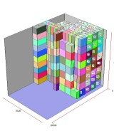
Integration: Integration between Cube-IQ and ExtendSim focused on simplicity
Cube-IQ has multiple methods of implementation:
Cube-IQ Web
Cube-IQ SOA (Service Oriented Architecture)
Cube-IQ BlackBox
With multiple forms of interoperability:
User Interface
CSV Files
XML Files
TCP Sockets
SOAP Server
Input Folder
Container
Munitions
Loaded
Unloaded
Image Folder
Output Folder
Process is fully autonomous
Depending on complexity, each load takes on the order of seconds to run
For our scenario, 10,000 container loads takes about 3-4 hours to run
Notes:
Cube-IQ can work on a server for multiple users, or sit independently on a stand alone computer.
There are multiple ways to communicate with Cube-IQ, ranging from very detailed TCP sockets, to rudimentary CSV files.
We aimed for simplicity and chose stand alone with CSV files.
Animation shows files being produced from ExtendSim and being dropped into a folder that is being continuously monitored by Cube-IQ. Once all needed files are present, they are sent to Cube-IQ for optimization. The output is two files that give the loaded and unloaded packages, as well as a third file that produces an image of the load.

Slide 13
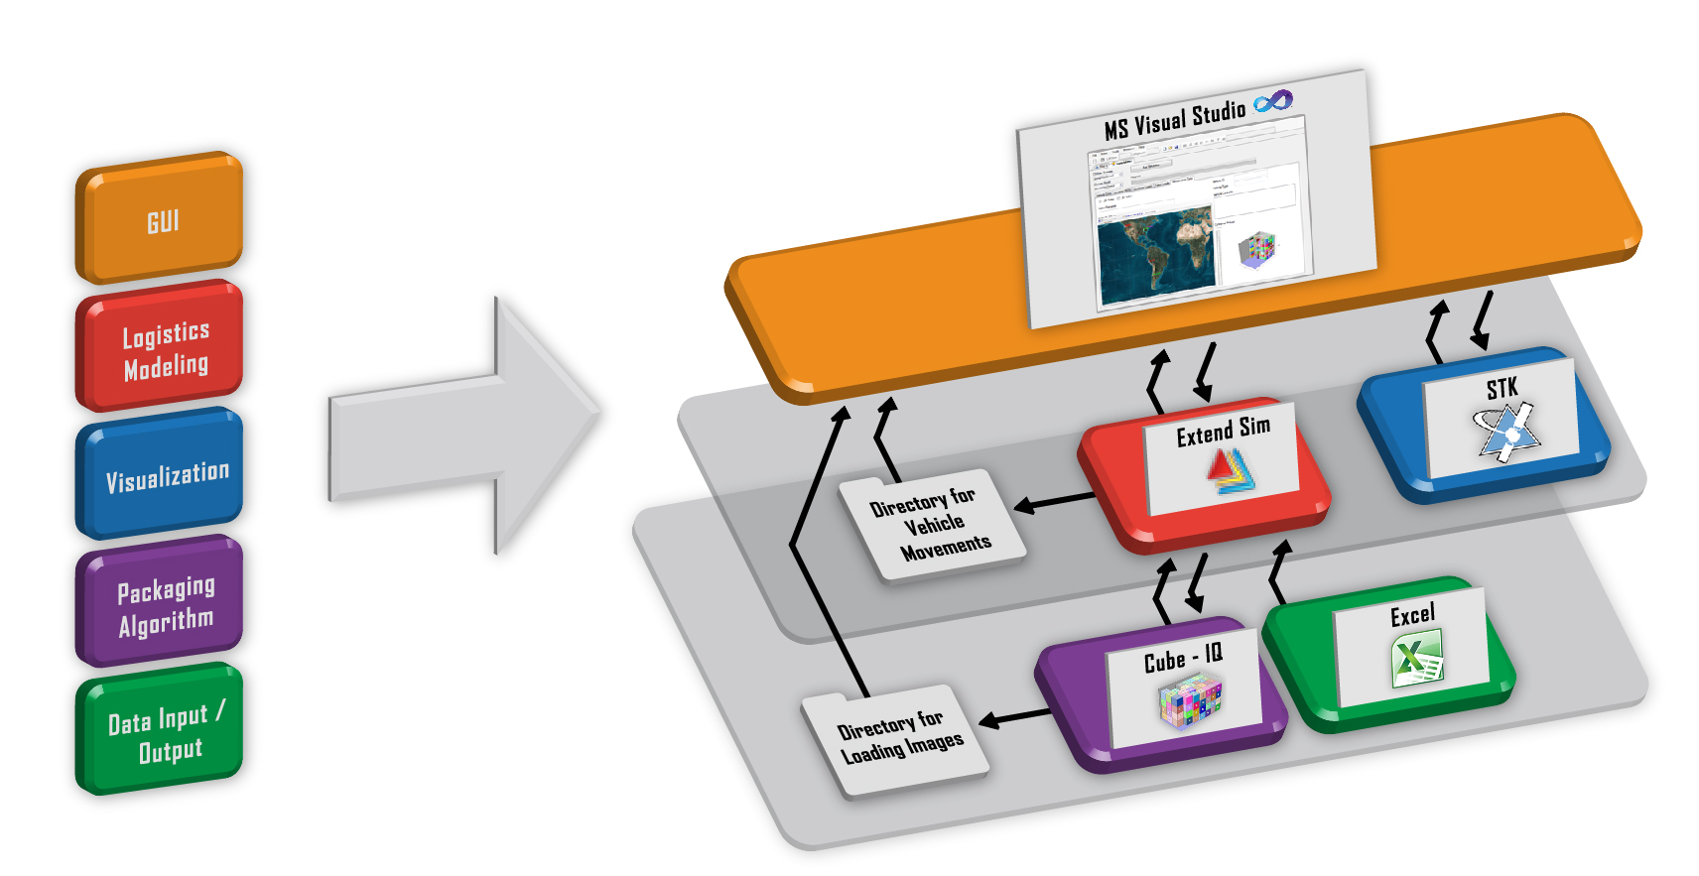
Integration: Full integration into one executable using MS Visual Studio Express is still underway
Notes:
Overview of the full integration of model
Briefly discuss pulling images from Cube-IQ and relating them to data in ExtendSim using the GUI
Discuss ExtendSim being feeding the GUI most of the information, as well as the GUI being an input field for ExtendSim
Discuss STK sitting as an add-on for visualization. We have made it so it is not integral to the model, but can be developed and included if needed. Also comment on this approach allows us to use other visualization software as well, like GE

Slide 14
AGENDA Project Overview Approach Integration Model Development Output and Analysis Q&A

Slide 15
Model Development: Multiple models were needed to address all aspects of scenario
Runtime
AIRLIFT FOCUS
Complexity
Segment
I
Land Movement
Segment II
APOE-APOD
Air Movement
Segment
III
APOD-Destination
Land Movement
Origin-APOE
No recombining
Same Origin-APOE-APOD-Destination
Pallet Loading
Model 1
Model 2
Model 3
Runtime
SEALIFT FOCUS
Segment
I
Land Movement
Segment II
SPOE-SPOD
Sea Movement
Segment
III
SPOD-Destination
Land Movement
Origin-SPOE
No recombining
Same Origin-SPOE-SPOD-Destination
Container Loading
Model 4
Model 5
Notes:
Discuss the different aspects of the process
Detail where different models needed to be used. For instance, Pallet and container loading was separate due to run-time. We could complete the loading once, then run the model with different parameters and produce results in 5-10 minutes as opposed to 4 hours a run. Allowed us to use optimization as well
Broke Airlift in two due to complexity between vehicle arrival at a POE and Pallet arrival at POE.
Sealift was more straightforward and allowed us to make one congruent model

Slide 16
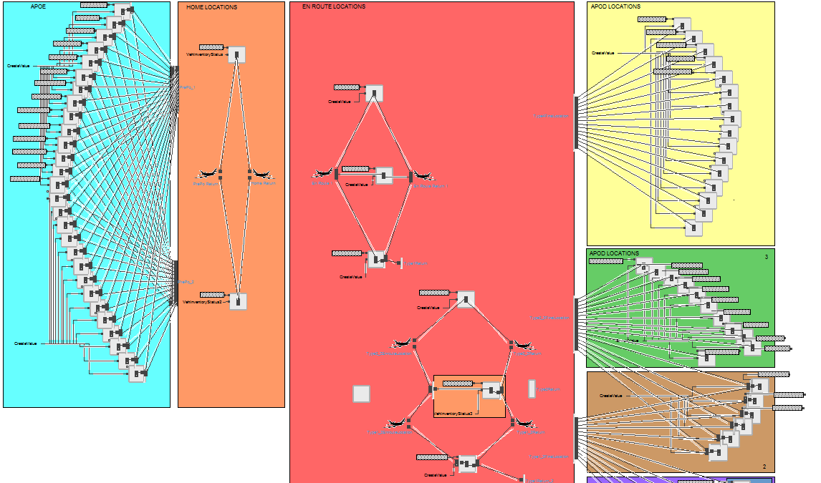
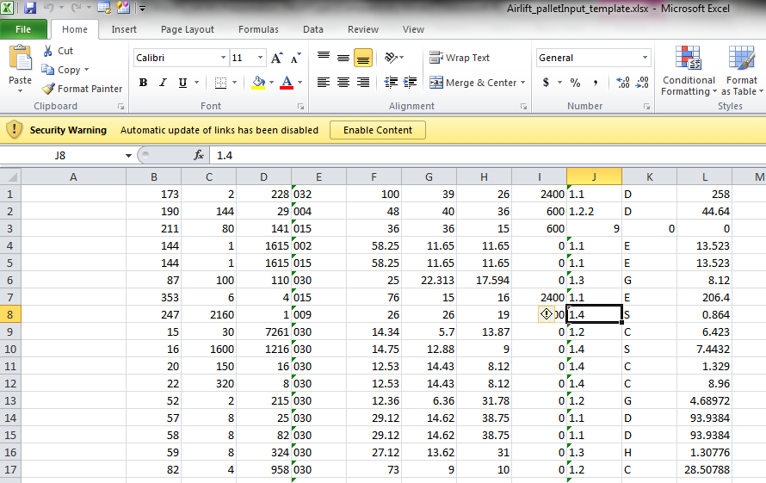
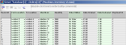
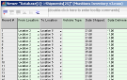

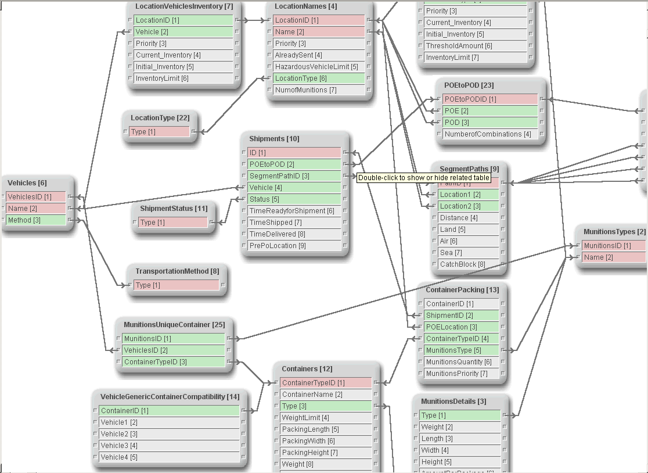
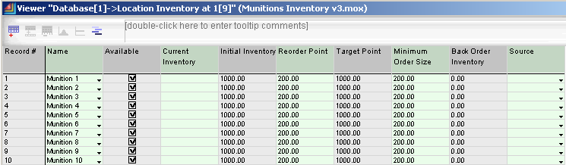
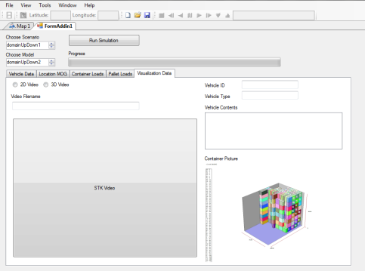
Model Development: ExtendSim was the primary component that drove functionality
ExtendSim acted as the “brain” of the model, driving logic and data flow
We were able to create custom code, which allowed us to meet the unique rule sets of the scenario while utilizing the out-of-the box capabilities such as pre-built blocks, event-logging, and import/export functionality.
The database within ExtendSim also served as our main repository for all model variables, inputs, and outputs. The database feeds all the external software applications.
Notes:
Discuss the left-most image as the model that allowed use to run all the logistics and incorporate custom code to capture unique logic such as hazmat compatibility, vehicle loading configurations, and requirement priorities.
The central images show the database where all the model variables and requirements were stored. This worked as the main interface feeding all data between all the components, including ingesting from excel and exporting to excel for easy external viewing.

Slide 17
AGENDA Project Overview Approach Integration Model Development Output and Analysis Q&A

Slide 18
Output and Analysis: Output data can be as detailed as needed, but can also be cleanly summarized
The model currently produces over 20 excel sheets of detailed information containing
Pallet Contents (each commodity, commodity quantity, total weight, RDD, delivery time etc)
Container Contents (each commodity, commodity quantity, total weight, RDD, delivery time etc)
Vehicle Contents (Number of pallets/containers, Specific pallet/container, weight, RDD, etc)
End-to-End Pallet path (each node through distribution, duration at node)
End-to-End Container path (each node through distribution, duration at node)
Nodal details (Max NEW/day, average vehicle wait time, number of total vehicles)
Number of trucks needed for each Origin/day
Number of rail cars needed for each Origin/Day
Daily number of Ship departures per SPOE
Number of trucks needed at POD per Destination
We have summarized this data into two Excel Sheets (Airlift and Sealift) to produce the numbers that are of interest to those conducting the analysis
Percent of airlift and sealift requirements making RDD
Number of aircraft and ships needed
Percent of pallet, container, and vehicle used by weight
Total short tons moved by service
Notes:
Brief overview of output to show flexibility in data that can be derived from model

Slide 19
Output and Analysis: Analysis may illuminate multiple aspects of OPLAN
We have used the model to:
Test validity of OPLAN with current resources
Highlight potential bottlenecks
Conduct a sensitivity analysis and highlight high points of risk in distribution network
Provide estimation for number of resources that are needed for success
Conduct initial optimization analysis to further understand interactions and relationships between variables within model
Test secondary excursions for potential improvements to OPLAN
Notes:
Talk about running baseline scenario to understand current capabilities
Run sensitivity analysis with multiple variables to understand impact areas where greatest improvements can be made
Run optimization with an objective function to better define what is needed for success and further understand the complex relationship between variables
All of this allowed us to provide meaningful recommendations to client and highlight potential areas of improvement as well as risk

Slide 20
Output and Analysis: Future Work will aim towards model validation
Formal independent Verification and Validation has not been done, but we continue to work with PACOM to validate the model:
Conducted higher level analyses throughout model development to ensure results were logical and we understood the “why” of results
Compared volume optimization with generic load plans to ensure our loading estimates were reasonable
Joint Staff J4 is conducting a model focusing on Segment I distribution that we will use for comparison
CNA and USTC JDPAC have examined strategic transportation and distribution in the past and will continue to do so. We will be looking for future studies from them as well as others in the field for potential validation
Investigating running an analysis using JFAST (Joint Flow and Analysis System for Transportation) to help validate sealift and airlift throughput
SMEs have looked at model outputs and so far they assess that the model is satisfactorily modeling reality. Until we further validate the model, PACOM J4 remains cautious but optimistic that PALITS can pass VV&A
Notes:
Validation is something we have discussed, and due to the scenario, find it hard to fully conduct.
Discussed multiple ways we can still try and validate model and improve confidence in results
At the end of the day, this analysis has not been done before. While we would like and aim to fully validate our model, this model has produced results that were wildly unknown before. We at least now have a foundation to move forward with analytical rigor for support.

Slide 21
AGENDA Project Overview Approach Integration Model Development Output and Analysis Q&A

Slide 22
Back-Up Slides

Slide 23
Integration: Integration between ExtendSim and Excel is trivial due to out-of-the-box capabilities
Client Input files were in Excel format
ExtendSim has built-in functions that allow for simple and straightforward ingesting of Excel data into ExtendSim database tables
This process can be made automatic or man-in the-loop
Desire for output to be in Excel format for simplicity in understanding, analyzing, and distributing
ExtendSim has built-in functions that allow for simple and straightforward exporting of ExtendSim database tables into Excel spreadsheets
This process can be made automatic or man-in the-loop
ExtendSim can also run Excel macros for automatic formatting

Slide 24
Integration: Integration between ExtendSim and STK leveraged STK’s engine application
AGI provides multiple versions of its STK Software
STK Full Version
STK Engine Application
STK Components
We chose the STK Engine Application for it’s ability to:
Strip away superfluous functionality and create unique interfaces specific to the user
Utilize AGI’s well defined object model and API for software development
Produce 2-D and 3-D visualizations
Package the necessary functionality of the model in a license-enabled executable
Visualization could occur simultaneously with simulation, or after simulation
Simultaneous visualization would be system-intensive and increase runtime
We elected to visualize events of the model post-simulation
Post-simulation visualization takes about 3 hours for full loading of 10,000 objects into STK
Once objects are loaded, playback and interaction have no noticeable lag or delay
Notes:
Went with STK Engine Application because of it’s ability to quickly embed visualizations within a GU and produce an executable for the end user.
Multiple methods for employing video, could be real time or post simulation
We believe real-time would cause lag in video, as well as a much longer run-time for the model itself. So we decided to employ the video post simulation.
We have a sample executable that creates a video of 10,000 objects. We are looking to reduce run-time through some optimizing the code.

